Slide 1


Data Mining Life Cycles
Luis Miralles

Slide 2
Lesson Outline
Section 1: Understanding the data
Section 2: Why do we need a Life Cycle?
Section 3: Cross-Industry Standard Process for Data Mining (CRISP-DM)
Section 4: CRISP-DM main steps
Section 5: CRISP-DM Documentation

Slide 3
Summary of lecture
This lecture discusses the importance of a structured data mining process, focusing on the Cross-Industry Standard Process for Data Mining (CRISP-DM).
It highlights vital sections, including understanding the data, the necessity of a life cycle, and the main steps within CRISP-DM.
The emphasis lies on systematic and efficient data mining, leveraging CRISP-DM's flexibility and iterative approach for successful project management.
It underscores the crucial role of documentation in ensuring transparency, reproducibility, and collaboration throughout the data mining life cycle.

Slide 4

Section 1: Understanding the data

Slide 5

Question
What is the most critical thing for extracting valuable information from an organisation?

Slide 6
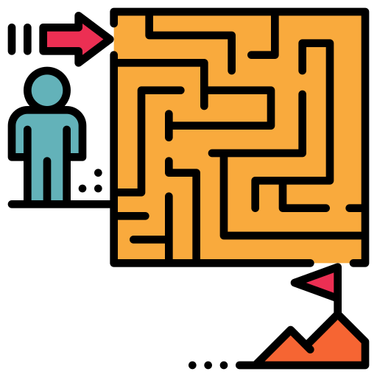
What is the most important thing for you’re a good data science?
Understand what is valuable for the business. Try to answer the research question

Slide 7

Brexit
Explains how online advertising
can be used to change political
perspectives.
Dominic Cummings
https://www.youtube.com/watch?v=E5S1EMmCWAE

Slide 8
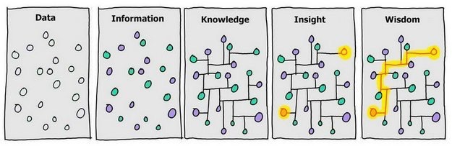
Stage 1: Data
This could mean something or nothing

Slide 9
Stage II: Information
The previous data gives the meaning, but it is very elementary.
Example: Differentiating between "Man and Woman”, “Republican and Democrat”, “Pro-Brexit and anti-Brexit”…

Slide 10
Stage III: Knowledge
Knowledge comes when we start to be aware of specific patterns.
- Households (< £20,000 per year) likely to support Brexit
- People with no degree have 30% higher support than people with a degree.
https://www.jrf.org.uk/report/brexit-vote-explained-poverty-low-skills-and-lack-opportunities

Slide 11
Stage IV: Insight
This is when we can find useful knowledge —the kind that is not obvious at first glance.
- Certain low-income groups in Britain who felt ‘left behind’ were Brexit supporters.

Slide 12
Stage V: Wisdom
Ability to take action from your insights (decision-making) to achieve a goal. For example, throw an online campaign that supports a particular belief in a political campaign.

Slide 13
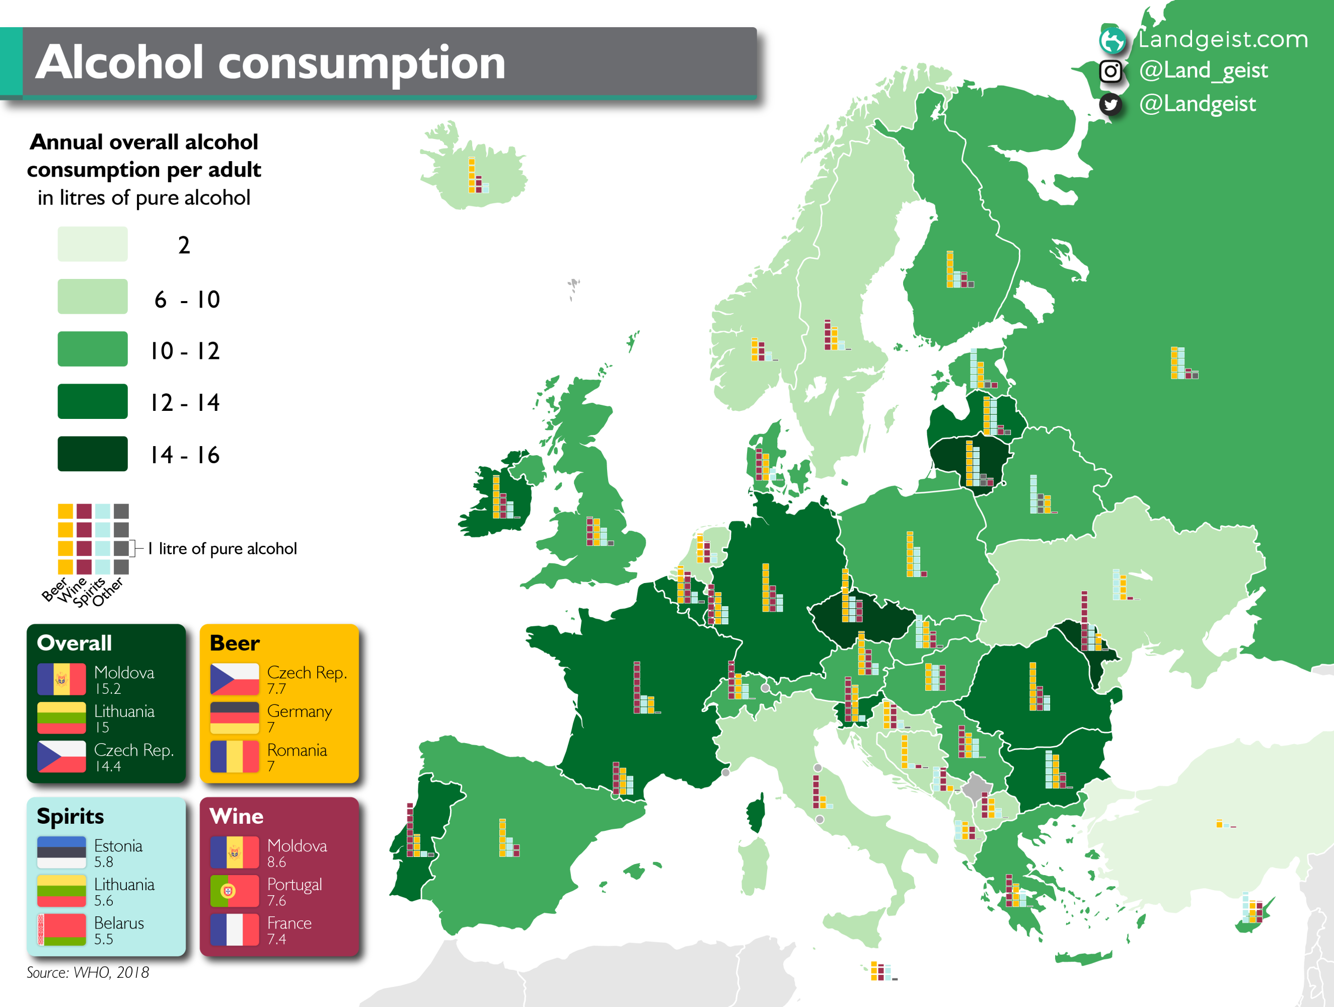
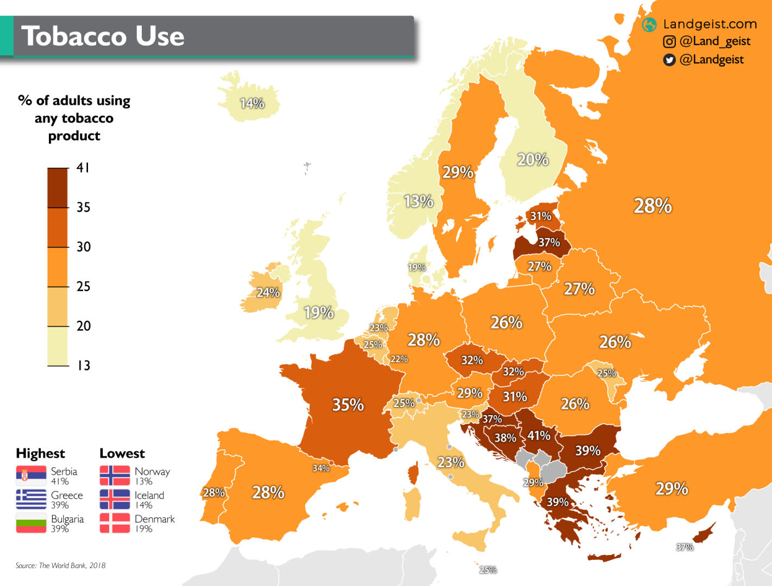
Main factors in tobacco and alcohol?
https://landgeist.com/2021/01/07/tobacco-use-in-europe/

Slide 14
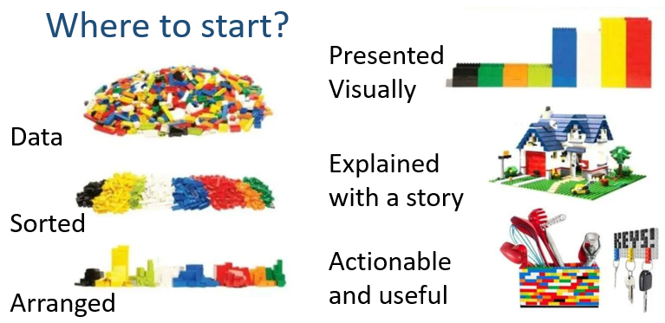

Slide 15

Section 2: Why do we need a Life Cycle?

Slide 16

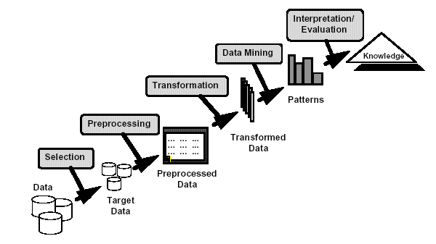
What is Data Mining?
Many definitions:
Definition 1: Non-trivial extraction of implicit, previously unknown, and potentially useful information from data
Definition 2: Exploration & analysis, by automatic or semi-automatic means, of large quantities of data to discover meaningful patterns
Knowledge Discovery Process
https://youtu.be/0PDq4wYZqP0
Notes:
The mining of gold from rocks or sand is referred to as gold mining rather than rock or sand mining.
Thus data mining should have been more appropriately named “knowledge mining from data” which is unfortunately somewhat long.
A shorter term “Knowledge mining” may not reflect the emphasis on mining from large amounts of data. Nevertheless mining is a vivid term characterising the process that finds a small set of precious nuggets from a great deal of raw material

Slide 17
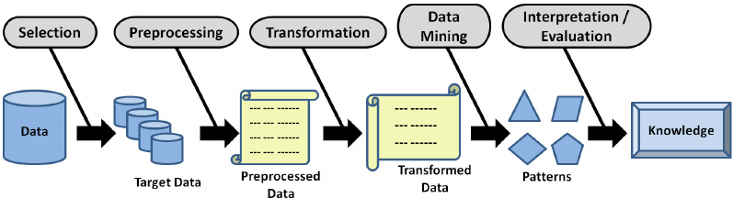
Knowledge Discovery in Databases (KDD)
KDD is a standardised process in data mining to find helpful information in the data.
Gullo, Francesco. "From patterns in data to knowledge discovery: What data mining can do." Physics Procedia 62 (2015): 18-22.

Slide 18
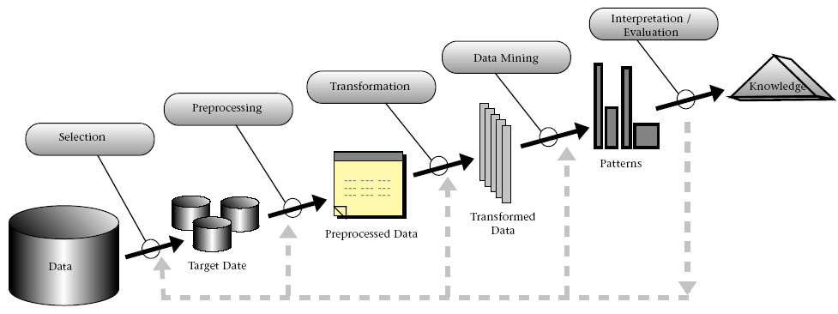
Steps of a KDD Process
Learning the application domain
Relevant prior knowledge and goals of the application
Creating a target data set: data selection
Data cleaning and preprocessing
It may take 70% of the effort!
Data reduction and transformation
Find useful features, dimensionality/variable reduction
Choosing functions of data mining
Classification, regression, clustering, etc.

Slide 19

Steps of a KDD Process
Choosing the mining algorithm(s)
Data mining: search for patterns of interest
Pattern evaluation and knowledge presentation
Visualisation, transformation, removing redundant patterns, etc.
Use of discovered knowledge
One of the ideas of KDD is to automate the boring stuff!

Slide 20
The KDD Process
This can take up to 70% of the time

Slide 21
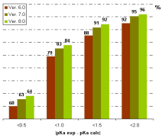
The KDD Process – with a Data Warehouse
Knowledge
“Data Science is 70% data preparation and 30% playing around with it”
Evaluation & Presentation
Data Mining
Selection & Transformation
Data Warehouse
Cleaning & Integration
Central repository of information
Databases

Slide 22

When doing data mining…
This is not making pancakes. No procedure applies systematically, one step after the other, without overthinking in between.
Doing that is not much value, and every problem is different.
Generally speaking, there is no unique solution either

Slide 23

Stop and think!
This is the most essential part of data mining and data science.
You need to stop, analyse, ask questions, do some research, see the big picture, understand the business, and come up with the right insights for the organisation to make the right decisions.

Slide 24


Importance of listening:
What kind of analytics is needed?
Always start with questions
Learn to listen
Try to figure out what is to be achieved
Do not rush or jump to conclusions!
In many cases, you don’t need ML !!!
It must take time to learn how to do this!
It comes with experience.
Listening is a very valuable skill!

Slide 25
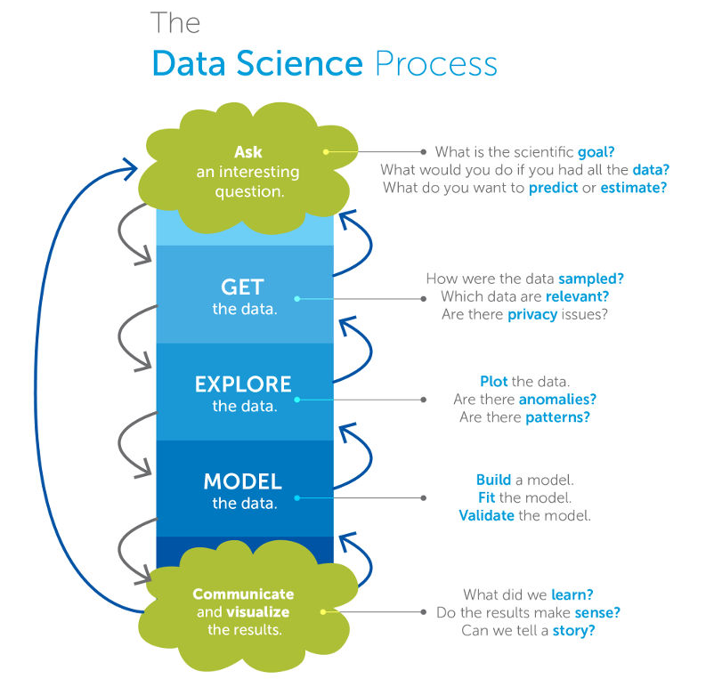
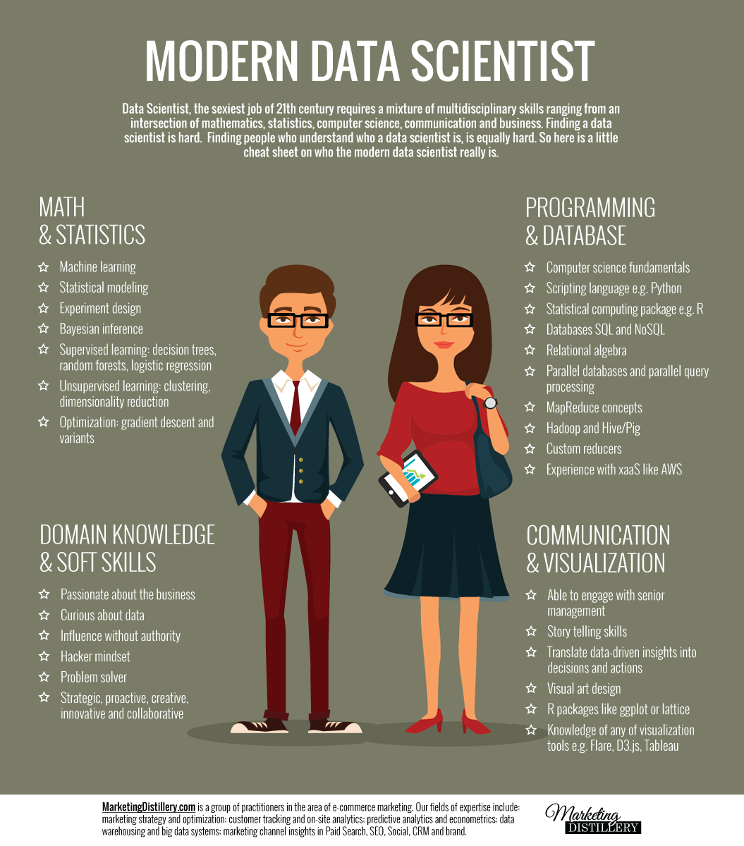
https://cs109.org

Slide 26








- Who are you doing this for?
- What sections is this for?
- What is in it for them?
- What is the value for them?
- How do we get access to data?
- How much of the data is available?
- How do we integrate?
- How can this be measured?
- What are you going to do?
- What do you want to achieve?
- What’s the business value?
- Why is this needed?
- What has been done before?
- Why has previous not worked?
- What are the business divers?
- Where will it be used?
- What department, applications, and processes?
- What does it interface with?
- What are the important timings?
- When is this needed?
- When are the results needed?
- What are the critical timeframes?
- How does it fit into the strategic goals?

Slide 27






Problems related to Human factor
Employees do not
want to share
Some people do
not want to work
too much
Some people may
be envious
if you get credit
Some information could
reveal unethical behavior
They do not have the data
but will never tell you
Try not to be rude
when asking for information

Slide 28
Example of Data Preparation
NAME | GENDER | CITY | STATE | DOB
John | Male | Brooklyn | New York | 12/02/86
Susan | Female | (blank) | NY | 5-Apr-1972
David | Male | Boston | MA | 1981-07-14
Maria | Female | Miami | Florida | 03/08/85
Alex | M | Chicago | IL | 15 Sept 1990
Linda | F | Los Angeles | CA | 08-21-1978
Robert | Male | Houston | TX | 1975/12/01
Emma | Female | Seattle | WA | 04/04/1992

Slide 29

Section 3: Cross-Industry Standard Process for Data Mining (CRISP-DM)

Slide 30

Case Study: Predicting Diabetes Risk
Problem: Hospitals face a growing challenge with diabetes, a condition that develops gradually and often remains undiagnosed until serious complications occur. Many patients who regularly visit the hospital for routine checkups already show early risk factors (such as obesity, high blood pressure, or elevated glucose levels), but doctors cannot always spot these patterns during short consultations.
Key challenge: How can the hospital use its large collection of patient data to identify individuals most at risk of developing diabetes in the next few years, so preventive action can be taken?

Slide 31
Applying CRISP-DM to Predict Diabetes Risk in Patients
Solution (CRISP-DM):
Business Understanding – Goal: predict diabetes risk to enable prevention.
Data Understanding – Collect patient data (EHR, lab results, lifestyle).
Data Preparation – Clean missing values, normalise numbers, encode categories.
Modelling – Train ML models (e.g., logistic regression, decision trees).
Evaluation – Test accuracy and recall (avoid missing high-risk patients).
Deployment – Integrate into the hospital system, giving doctors a risk score at checkups.
Outcome:
Doctors can act early with lifestyle advice or extra tests, reducing future diabetes cases.

Slide 32
CRISP-DM: Data Mining Process
Cross-Industry Standard Process for Data Mining (CRISP-DM)
European Community-funded effort to develop a framework for data mining tasks
Goals:
Encourage interoperable tools across the entire data mining process
Take the mystery/high-priced expertise out of simple data mining tasks

Slide 33

Why Should There be a Standard Process?
Framework for recording experience
Allows projects to be replicated
Aid in project planning and management
“Comfort factor” for new adopters
Demonstrates the maturity of Data Mining
Reduces dependency on “stars”
Same idea with accountants
The data mining process must be reliable and repeatable by people
with little data mining background.

Slide 34
Process Standardization
CRoss Industry Standard Process for Data Mining (CRISP-DM)
An initiative launched in September 1996
SPSS/ISL, NCR, Daimler-Benz, OHRA
Funding from the European Commission
Over 200 members of the CRISP-DM SIG worldwide
DM Vendors include SPSS, NCR, IBM, SAS, SGI, Data Distilleries, Syllogic, Magnify, and others.
System Suppliers/consultants - Cap Gemini, ICL Retail, Deloitte & Touche, …
End Users - BT, ABB, Lloyds Bank, AirTouch, Experian, ...

Slide 35
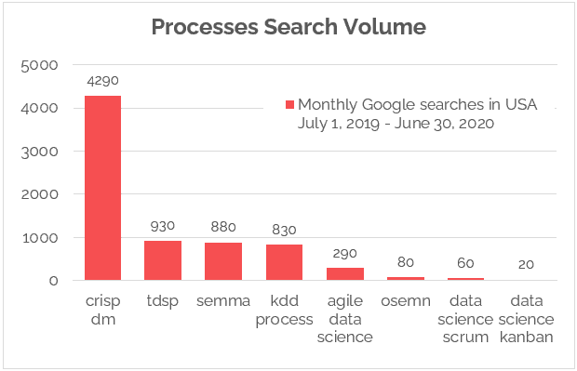
CRISP-DM is Still the Most Popular Framework
Statistics about Crisp-DM
SEMMA is not, however, a comprehensive project management template as CRISP-DM.
The acronym SEMMA -- sample, explore, modify, model, assess -- refers to the core process of conducting data mining.
https://www.datascience-pm.com/crisp-dm-still-most-popular/

Slide 36

CRISP-DM
Non-proprietary
Application/Industry neutral
Tool neutral
Focus on business issues
As well as technical analysis
Framework for guidance
Experience base
Templates for Analysis

Slide 37
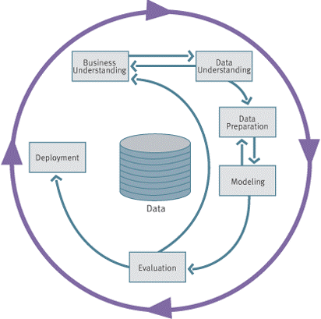
CRISP-DM: Overview

Slide 38
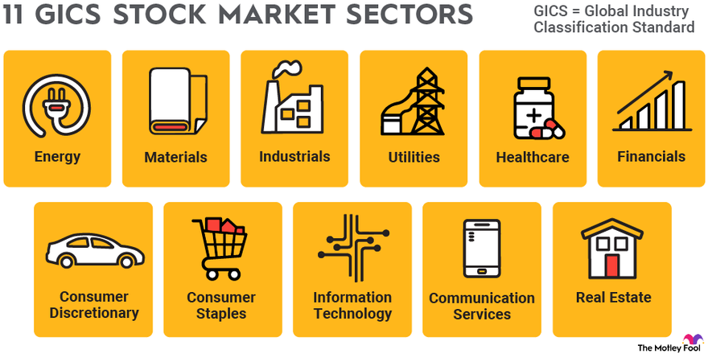
There are 11 different stock market sectors

Slide 39

CRISP-DM: Overview
Any project has two challenging and time-consuming parts.
1. Defining the business question:
What are you trying to do?
What has been done previously?
What do we already know?
What do we not know?
What kind of analytical techniques will or may help?
Maybe machine learning is one such analytical technique
Perhaps we don’t need machine learning?

Slide 40

CRISP-DM: Overview
2. Defining and preparing the data
Is it captured?
Do we have access to it?
Are we allowed to use it?
Should we be using it? (EU GDPR)
How can it be integrated?
What data cleaning is needed?
What transformations are needed?

Slide 41
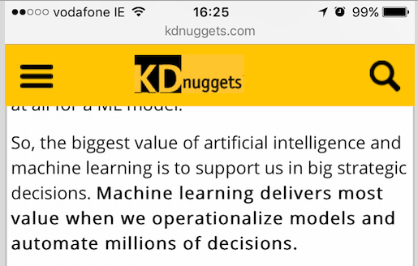
CRISP-DM: Overview
The forgotten parts of the process or the parts that very few people talk about
1
Focus hard on the Business Question (and the relevant variables) that captures the essence of the question.
2
Don’t forget this is the most critical step.

Slide 42

CRISP-DM main steps
Business Understanding:
Understand the project's objectives and business goals, and define the problem you aim to solve with data mining.
Data Understanding:
Gather and explore data to gain insights into its quality, structure, and relevance to the problem. This step often involves data collection, profiling, and initial data analysis.
Data Preparation:
Preprocess and clean the data to make it suitable for modelling. Tasks include handling missing values, dealing with outliers, and transforming variables.

Slide 43
CRISP-DM main steps
Modelling:
Select and apply appropriate data mining and machine learning techniques to build and evaluate models. This step includes selecting algorithms and training models and assessing their performance.
Evaluation:
Assess the quality and effectiveness of the models developed in the previous step. This involves metrics, cross-validation, and comparing model performance against the project's goals.
Deployment:
Deploy the selected model(s) into the production environment for real-world use. This step may involve integrating the model into business processes and monitoring its performance over time.

Slide 44
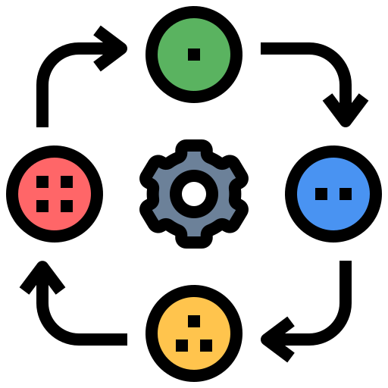
CRISP-DM: Phases
Business Understanding
Understanding project objectives and requirements
Data mining problem definition
Data Understanding
Initial data collection and familiarisation
Identify data quality issues
Initial, obvious results
Data Preparation
Record and attribute selection
Data cleansing
Modelling
Run the data mining tools
Evaluation
Determine if results meet business objectives
Identify business issues that should have been addressed earlier
Deployment
Put the resulting models into practice
Set up for repeated/continuous mining of the data

Slide 45
Aspect | CRISP-DM | KDD
Full Name | Cross-Industry Standard Process for Data Mining | Knowledge Discovery in Databases
Year Founded | 1996 | 1989
Founders | Consortium led by Daimler-Benz, NCR, OHRA | Pioneered by Usama Fayyad, Gregory Piatetsky-Shapiro, and Ramasamy Uthurusamy
Purpose | A standardized, structured approach to data mining projects | A process focused on discovering useful knowledge from large datasets
Stages | 1. Business Understanding 2. Data Understanding 3. Data Preparation 4. Modelling 5. Evaluation 6. Deployment | 1. Data Selection 2. Data Preprocessing 3. Data Transformation 4. Data Mining 5. Interpretation/Evaluation
Focus | Business and industry-focused data mining process | Research and discovery of new patterns or insights in large datasets
Industry Application | Widely used across industries for business-driven data mining projects | Primarily used in academic research and large-scale data analysis
Flexibility | Structured but flexible enough to adapt to different industries | Emphasizes flexibility in discovering patterns without strict business objectives
Primary Output | Deployable models for decision-making and business processes | Discoveries and insights from data, often resulting in publications or new algorithms

Slide 46

Section 4: Case studies

Slide 47

1. E-commerce Recommendation System:
Problem:
An e-commerce platform is looking to boost sales and improve user experience.
They aim to implement a data mining-based recommendation system that suggests products to users based on their browsing and purchase history.

Slide 48
1. E-commerce Recommendation System
Solution:
The solution involves implementing collaborative filtering and content-based recommendation algorithms. By analysing user behaviour, purchase history, and product attributes, the system can generate personalised product recommendations for each user.
Continuous monitoring and fine-tuning of the recommendation engine will ensure that users receive relevant and engaging product suggestions, which will increase sales and improve user satisfaction.
Examples: Netflix, Amazon, eBay, etc.

Slide 49

2. Healthcare Patient Outcome Prediction:
Problem:
In the healthcare industry, a provider seeks to enhance patient care by predicting outcomes.
They want to identify high-risk cases and tailor treatment plans using historical medical records and treatment data.

Slide 50
2. Healthcare Patient Outcome Prediction:
Solution:
We will develop predictive models using machine learning algorithms to forecast patient outcomes. These models will consider factors such as patient demographics, medical history, and treatment plans to predict the likelihood of positive or negative consequences.
The healthcare provider can then use these predictions to allocate resources more efficiently, prioritise high-risk cases, and tailor treatment strategies to improve patient care and outcomes.

Slide 51

3. Fraud Detection for a Financial Institution:
Problem:
A financial institution faces many fraudulent transactions, resulting in substantial losses.
They must deploy a data mining solution to detect and prevent fraudulent activities, safeguarding their financial assets and customers.

Slide 52
3. Fraud Detection for a Financial Institution:
Solution:
Our solution involves implementing anomaly detection algorithms and machine learning models to identify fraudulent transactions in real time.
By analysing transaction data, user behaviour, and historical fraud patterns, the system can flag suspicious activities for further investigation or block them immediately. Continuous model updates and feedback loops will help adapt to fraud tactics, minimising financial losses and maintaining customer trust.

Slide 53

4. Social Media Sentiment Analysis:
Problem:
A marketing agency is keen to gauge public sentiment regarding their client's brand and products through social media.
They intend to use data mining techniques to analyse social media conversations, track sentiment trends, and respond more effectively to customer feedback.

Slide 54
4. Social Media Sentiment Analysis:
Solution:
We will employ natural language processing (NLP) and sentiment analysis techniques to analyse social media conversations and determine sentiment trends.
By monitoring public sentiment in real-time, the marketing agency can gauge customer opinions, identify potential issues, and respond promptly to customer feedback.
Sentiment analysis insights will inform marketing strategies, product improvements, and crisis management efforts to enhance the client's brand reputation.

Slide 55

5. Energy Consumption Forecasting for Smart Grids:
Problem:
A utility company managing a smart grid infrastructure wants to optimize energy distribution.
Using data mining, they aim to predict energy consumption patterns across various regions and timeframes.
This will enable them to allocate resources more efficiently and enhance grid stability.

Slide 56
5. Energy Consumption Forecasting for Smart Grids:
Solution:
Our solution will leverage time series forecasting models to predict energy consumption patterns across various regions and timeframes.
The utility company can optimise energy distribution, reduce waste, and improve grid stability by analysing historical consumption data, weather conditions, and grid performance.
This predictive capability will enable proactive resource allocation, demand response programs, and efficient energy management, resulting in a more innovative and sustainable grid.

Slide 57

Section 5: CRISP-DM main steps

Slide 58
Phases in the DM Process – Business Understanding
Business
Understanding
Data
Understanding
Data
Preparation
Modeling
Evaluation
Deployment
Business Understanding
Statement of Business Objective.
State goal in business terminology.
Statement of Data Mining objective.
States objectives in technical terms.
Statement of Success Criteria.
It focuses on understanding the project objectives and requirements from a business perspective and then converting this knowledge into a data mining problem definition and a preliminary plan to achieve the goals.
What does the client want to accomplish?
Uncover important factors (constraints, competing objectives).
Determine Business
Objective
Assess
Situation
Determine
Data Mining
Goals
Produce
Project Plan

Slide 59
Phases 1 – Business Understanding
Determine business objectives
Key persons and their roles? Is there a steering committee? Internal sponsor (financial, domain expert).
Business units impacted by the project (sales, finance…)? Business success criteria and who assesses it?
Users’ needs and expectations.
Describe the problem in general terms: business questions, Expected benefits.
Assess situation
Are they already using data mining?
Identify hardware and software available. Identify data sources and their types (online, experts, written documentation).
Identify knowledge sources and types (online, experts, written documentation)
Describe the relevant background.

Slide 60

Phases 1 – Business Understanding
Determine data mining goals.
Translate the business questions to data mining goals.
(e.g., a marketing campaign requires segmentation of customers to decide whom to approach in this campaign; the level/size of the segments should be specified).
Specify data mining problem type.
(e.g., classification, description, prediction, and clustering).
Specify criteria for model assessment.
Produce project plan
Define the initial process plan; discuss its feasibility with involved personnel.
Put identified goals and selected techniques into a coherent procedure.
Estimate effort and resources needed; Identify critical steps.
Marketing

Slide 61
Key Questions for Business Understanding
What are we trying to achieve, business-wise? Why is it important?
What are the inputs and outputs for the task we are trying to solve?
Are there any GDPR issues, such as people’s data or images?
How would a hypothetical solution to that task affect our operations? (Another way to ask this question is to assume I have a perfect solution to your machine learning task. How will you use it?)
Can we act based on such a solution, or must we develop that ability? (If the ability is there, learn it carefully. If not, keep close contact with the team that is responsible for creating it)
How are we going to measure a suggested solution? (KPIs)

Slide 62
Key Questions at end of Business Understanding
What would make it a success?
Do we have the input data available? How hard it is to extract it? Are we allowed to use it?
Are we experienced with building similar solutions? Do we understand what it takes?
Do we have a rigid budget and timeline constraints?
Who will develop the solution? Do we have the required skills in-house?
What analytics have we used already? What are the limitations of these approaches?

Slide 63
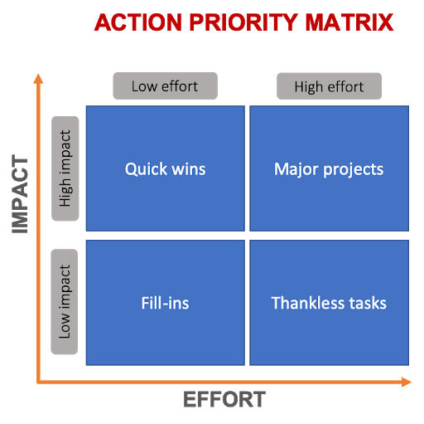
Start with the Quick Wins
"Quick wins" refer to relatively small-scale, low-effort, and high-impact accomplishments or improvements that can be achieved in a short period of time.
Process Efficiency Improvements
Cost Reduction
Customer Satisfaction
Quality Improvement
Marketing and Sales
Employee Engagement
Technology Adoption
Data Analysis and Insights
Risk Mitigation
Time Management
https://www.productplan.com/glossary/action-priority-matrix/

Slide 64
Phase 2 – Data Understanding
Business
Understanding
Data
Understanding
Data
Preparation
Modeling
Evaluation
Deployment
Collect
Initial
Data
Acquire the data
Explore the data (query & visualization)
Verify the quality
Starts with an initial data collection and proceeds with activities to get familiar with the data, identify data quality problems, discover first insights into the data, or detect interesting subsets to form hypotheses for hidden information.
Describe
Data
Explore
Data
Verify
Data
Quality

Slide 65
Phase 2 – Data Understanding
Collect data
List the datasets acquired (locations, methods used to acquire, problems encountered, and solutions achieved).
Describe data
Check data volume and examine its gross properties.
Accessibility and availability of attributes. Attribute types, range, correlations, the identities.
Understand the meaning of each attribute and attribute value in business terms.
For each attribute, compute basic statistics (e.g., distribution, average, max, min, standard deviation, variance, mode, skewness).
How good are your Database and Data Integration skills?

Slide 66
Phase 2 – Data Understanding
Explore data
Analyse properties of attractive attributes in detail.
Distribution, relations between pairs or small numbers of attributes, properties of significant sub-populations, simple statistical analyses.
Verify data quality
Identify particular values and catalogue their meaning.
Does it cover all the cases required? Does it contain errors, and how common are they?
Identify missing attributes and blank fields, which means missing data.
Do the meanings of attributes and contained values fit together?
Check the spelling of values (e.g., same value but sometimes beginning with a lowercase letter, sometimes with an uppercase letter).
Check for plausibility of values (e.g. all fields have the same or nearly the same values).

Slide 67
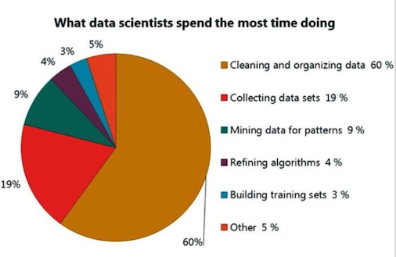
Where does the data scientist's time go?
There are two complicated and time-consuming parts to any project
Defining and preparing the data
This is way, way harder than you think
It does take a long time
Even with ‘small’ data
Lots of politics
Data is never clean
Data is never easy to integrate
Data keeps changing

Slide 68
Phase 3 – Data Preparation
Business
Understanding
Data
Understanding
Data
Preparation
Modeling
Evaluation
Deployment
Select
Data
Data preparation:
Collection
Assessment
Consolidation and Cleaning
Table links, aggregation level, missing values, etc.
Data selection
Active role in ignoring non-contributory data? Outliers? Use of samples, Visualization tools
Transformations - create new variables
Covers all activities to construct the final dataset from the initial raw data. Data preparation tasks are likely to be performed multiple times and not in any prescribed order. Tasks include table, record, and attribute selection as well as transformation and cleaning of data for modeling tools.
Clean
Data
Construct
Data
Integrate
Data
Format
Data

Slide 69
Phase 3 – Data Preparation
Select data
Reconsider data selection criteria.
Decide which dataset will be used.
Collect appropriate additional data (internal or external).
Consider the use of sampling techniques.
Explain why specific data was included or excluded.
Clean data
Correct, remove, or ignore noise.
Decide how to deal with special values and their meaning (99 for marital status).
Aggregation level, missing values, etc.
Outliers?
How good are your Database and Data Integration skills?
70%-80% of Project time will involve processing and managing data => SQL

Slide 70
Phase 3 – Data Preparation
Construct data
Derived attributes.
Background knowledge.
How can missing attributes be constructed or imputed?
Integrate data
Integrate sources and store results (new tables and records).
Format Data
Rearranging attributes (Some tools have requirements on the order of the attributes, e.g., the first field being a unique identifier for each record or the last field being the outcome field the model is to predict).
Reordering records (Perhaps the modeling tool requires that the records be sorted according to the value of the outcome attribute).
Reformatted within-value (These are purely syntactic changes made to satisfy the requirements of the specific modeling tool, remove illegal characters, uppercase lowercase).
How good are your Database and Data Integration skills?

Slide 71
Phase 4 - Modelling
Ah, this is easy! It really is!
Business
Understanding
Data
Understanding
Data
Preparation
Modeling
Evaluation
Deployment
Model building
Select the modeling technique
(based upon the data mining objective)
Generate test design
Procedure to test model quality and validity
Build model
Parameter settings
Assess the model (rank the models)
Various modeling techniques are selected and applied and their parameters are calibrated to optimal values. Typically, there are several techniques for the same data mining problem type. Some techniques have specific requirements for the form of data. Therefore, stepping back into the data preparation phase is often necessary
Select
Modeling
Technique
Generate
Test Design
Build
Model
Assess
Model

Slide 72
Phase 4 - Modelling
Select modeling technique
Select technique.
Identify any built-in assumptions made by the technique about the data
(e.g., quality, format, distribution).
Compare these assumptions with those in the Data Description Report and make sure that these assumptions hold.
Preparation Phase if necessary.
Generate test design
Describe the intended plan for train, test, and evaluate the models.
How to divide the dataset into training, test, and validation sets.
Decide on necessary steps (number of iterations, number of folds, etc.).
Prepare data required for the test.

Slide 73
Phase 4 - Modelling
Build model
Set initial parameters and document reasons for choosing those values.
Run the selected technique on the input dataset, and post-process the data mining results (e.g., editing rules and displaying trees).
Record parameter settings used to produce the model.
Describe the model and its unique features, behaviour, and interpretation.

Slide 74
Phase 4 - Modelling
Assess model
Evaluate results concerning evaluation criteria. Rank results about success and evaluation criteria and select the best models.
Interpret results in business terms. Get comments from domain experts.
Check the plausibility of the model.
Check model against given knowledge base (discovered info. Novel and valuable?)
Check result reliability. Analyse potentials for the deployment of each result.

Slide 75

Phase 5 – Evaluation
But this can be difficult.
What does it all mean!
Business
Understanding
Data
Understanding
Data
Preparation
Modeling
Evaluation
Deployment
Model Evaluation
More thoroughly evaluate the model
Decide how to use the results
Methods and criteria depend on model type:
e.g., coincidence matrix with classification models and mean error rate with regression models.
Interpretation of model: essential or not, easy or hard depends on the algorithm.
Thoroughly evaluate the model and review the steps executed to construct it to ensure that it properly achieves the business objectives.
A key objective is to determine if there is an important business issue that has not been sufficiently considered. At the end of this phase, a decision on using the data mining results should be reached.
Evaluate
Results
Review
Process
Determine
Next Steps

Slide 76
Phase 5 – Evaluation
Evaluate results
Understand data mining results. Check impact for data mining goal.
Check the result against the knowledge base to see if it is novel and valuable.
Evaluate and assess results concerning business success criteria.
Rank results according to business success criteria. Check the resulting impact on the initial application goal.
Are there new business objectives? (address later in the project or new project?)
State conclusions for future data mining projects.

Slide 77
Phase 5 – Evaluation
Review of process
Summarise the process review (activities that are missed or should be repeated).
Overview of the data mining process. Is there any overlooked factor or task? (did we correctly build the model? Did we only use attributes that we are allowed to use and that are available for future analyses?)
Identify failures, misleading steps, possible alternative actions, and unexpected paths.
Review data mining results concerning business success.

Slide 78
Phase 5 – Evaluation
Determine next steps
Analyse the potential for deployment of each result. Estimate potential for improvement of the current process.
Check remaining resources to determine if they allow additional process iterations (or whether additional resources can be made available).
Recommend alternative continuations. Refine process plan.
Decision
Based on the results and process review, it has been decided how to proceed to the next stage (remaining resources and budget).
Rank the possible actions. Select one of the possible actions.
Document reasons for the choice.

Slide 79
Phases 6 - Deployment
No one talks about this.
I wonder why?
Business
Understanding
Data
Understanding
Data
Preparation
Modeling
Evaluation
Deployment
Deployment
Determine how the results need to be utilised
Who needs to use them?
How often do they need to be used
Deploy Data Mining results by:
Scoring a database, utilising results as business rules, and interactive scoring online.
The knowledge gained will need to be organized and presented so that the customer can use it. However, depending on the requirements, the deployment phase can be as simple as generating a report or as complex as implementing a repeatable data mining process across the enterprise.
Plan
Deployment
Plan Monitoring &
Maintenance
Produce Final
Report
Review
Project

Slide 80
Phases 6 - Deployment
Plan deployment
How will the knowledge or information be propagated to users? How will the use of the result be monitored, or its benefits be measured?
How will the model or software result be deployed within the organisation? How will its use be monitored and its benefits measured (where applicable)?
Identify possible problems when deploying the data mining results.
Plan monitoring and maintenance
What could change in the environment? How will accuracy be monitored?
When should the data mining model not be used anymore? What should happen if it could no longer be used? (Update model, new data mining project)
Will the business objectives of the use of the model change over time?
Deployment is not discussed in the literature or by the “Experts”. The real value of Data Mining is
how you use or embed it in your everyday applications

Slide 81
Phases 6 - Deployment
Produce a final report.
Identify reports needed (slide presentation, management summary, detailed findings, explanation of models, etc.). How well initial data mining goals have been met?
Identify target groups for reports. Outline the structure and contents of reports.
Select findings to be included in the reports. Write a report.
Review project
Interview people involved in the project. Interview end users. What could have been done better? Do they need additional support? Summarise feedback and write the experience documentation.
Analyse the process (what went right or wrong, what was done well, and what needs to be improved.).
Document the specific data mining process (How can results and experience of applying the model be fed back into the process?). Abstract from details to make the valuable experience for future projects.

Slide 82
CRISP-DM: Overview
The forgotten part / The part that is not talked about or discussed
Nobody talks
about this
Everyone only talks up
to this point

Slide 83

Framing the Question is Key = lots of models = lots of iterations = lots of learning

Slide 84

Section 6: CRISP-DM Documentation

Slide 85
CRISP-DM: Details
CRISP-DM suggests a comprehensive set of outputs that should result at each phase of the methodology
A complete set of document templates is also provided
20 pages model (overview)
30 pages user guide (step-by-step process, hints)
10-page “output” (suggested outline for a report on a data mining project)
See web page
NB (Note well). You must follow this for your assignment and use the suggested
report outline.

Slide 86
Why CRISP-DM?
The data mining process must be reliable and repeatable by people with little data mining skills
CRISP-DM provides a uniform framework for
Guidelines
Experience documentation
CRISP-DM is flexible to account for differences
Different business/agency problems
Different data
CRISP-DM is evolving
Being developed based on experience of using CRISP-DM

Slide 87

Documenting your work
Why do we document our work?
What is different about Data Science / AI / ML Projects?
Iterative
Gaps between phases and Iterations
People move on
Traditionally, CRISP-DM gives a framework for Documenting each Phase of the project
What was done?
Why was it done that way?
Results and Outcomes
Can you compare Changes and Results with each iteration?

Slide 88
ML Model Cards
Aim
Be easy to use and increase productivity for both consumers and producers
Be easy to understand for both data professionals and business people
Treat data as code: from creation through design reviews to deprecation
Make it easy to reach out to teams responsible for individual components
Be end-to-end: complete lineage of data sets, features, models, services, and metrics
Be modular to allow extension to additional components, such as experiments
Enable digging deeper: It must reinforce the ‘trust, but verify’ principle
Avoid information overload
Subset of what is covered by CRISP-DM
Mainly focused on ML steps
Airbnb, Facebook, Lyft, Netflix, Spotify, Uber, etc
https://databaseline.tech/ml-cards/

Slide 89
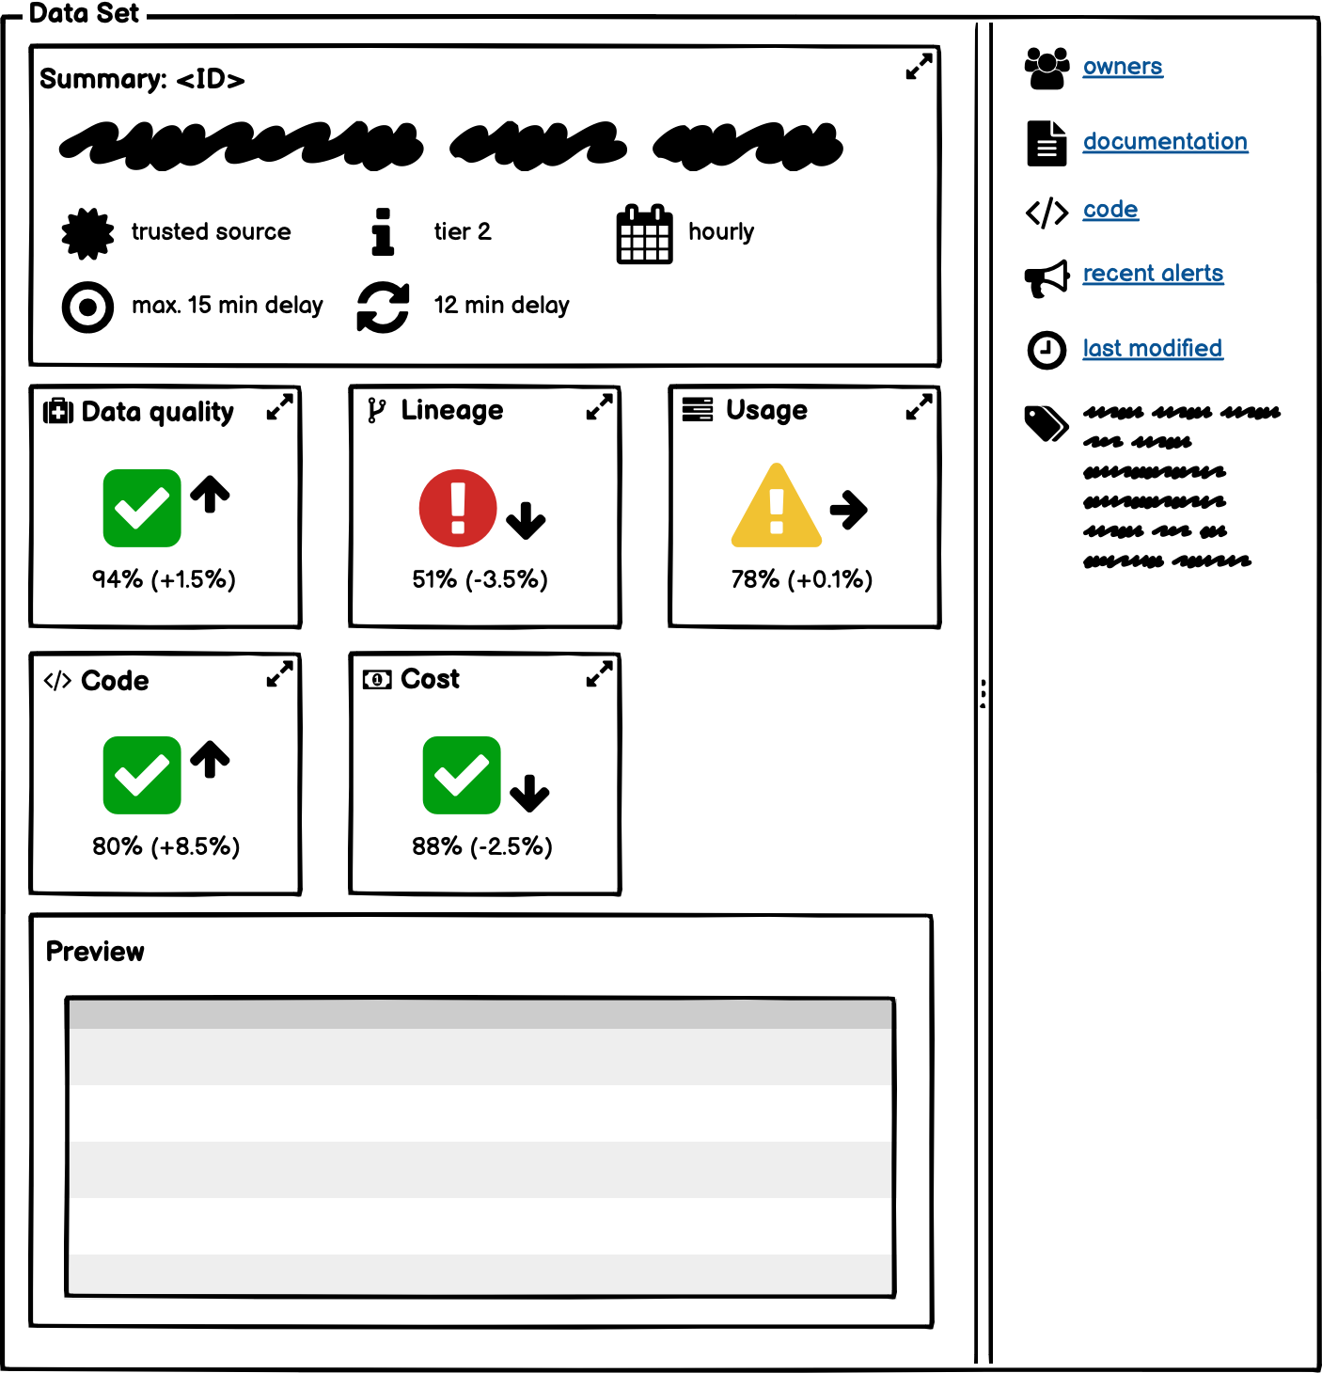
ML Model Cards
Summary card
Code card
Cost card
Lineage card
Components Data card
Data quality card
Usage card
Feature card
Model card
Service card
Metric card
https://databaseline.tech/ml-cards/

Slide 90
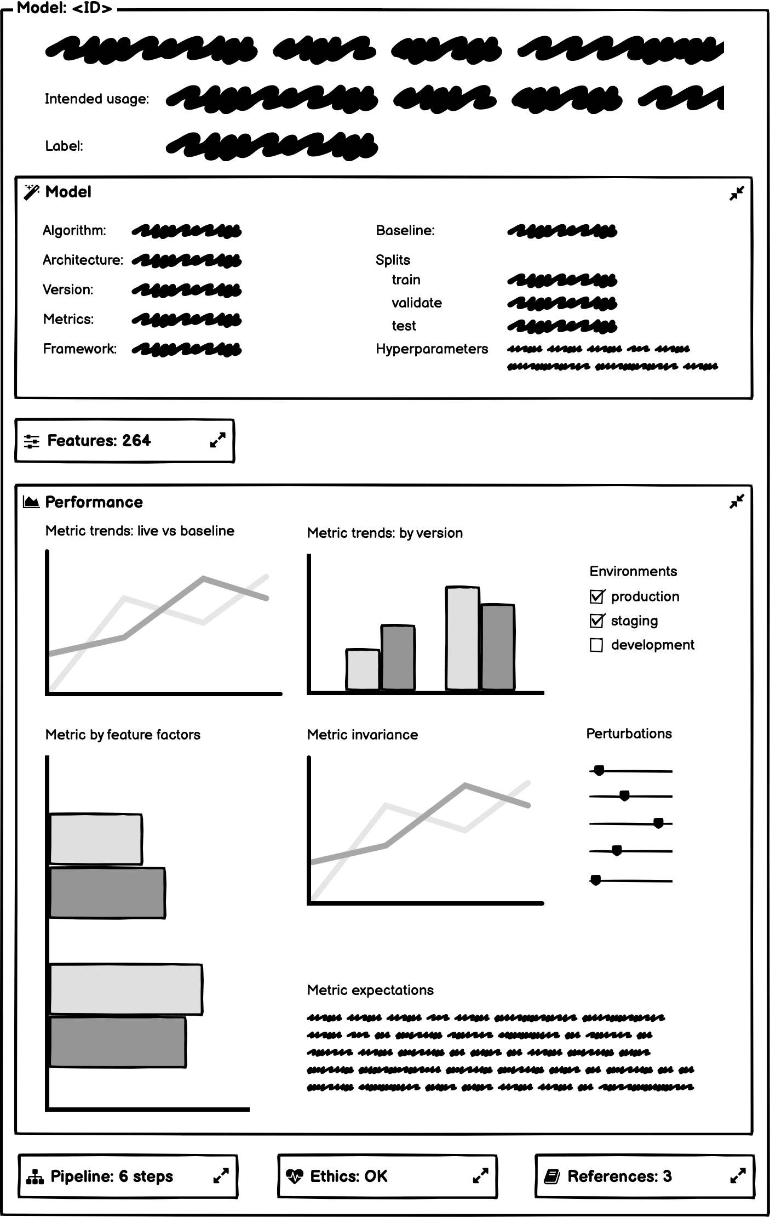
ML Card
Label (if applicable)
Features
Identifier
Correlations
Distributions (by environment)
Importance
TTL
Model performance
Metric(s) trend (by version/environment)
Baseline metric(s) trend
Live metric(s) trend (if applicable)
Metric(s) by feature factors
Metric(s) invariance
Expectations and behavioural requirements
Identifier
Description
Intended usage and limitations
Model
Algorithm
Architecture (if applicable)
Framework
Version
Baseline model
Data set splits for training, validation, and test
Hyperparameters
Evaluation metric(s)

Slide 91
Bibliography
https://devopedia.org/data-science
Flaticon.com
https://www.datascience-pm.com/wp-content/uploads/2021/08/CRISP-DM-for-Data-Science.pdf
https://s2.smu.edu/~mhd/8331f03/crisp.pdf
https://www.geeksforgeeks.org/top-50-data-mining-interview-questions-answers/

